Slide 1



Caffeine: Towards Uniformed Representation and Acceleration for Deep Convolutional Neural Networks
Chen Zhang^{1，2，3}, Zhenman Fang ², Peipei Zhou ², Peichen Pan ³, Jason Cong ^{1，2，3}
1 Center for Energy-Efficient Computing and Applications, Peking University, Beijing, China
2 Computer Science Department, University of California, Los Angeles, USA
3 Falcon-computing Solutions Inc.

Slide 2
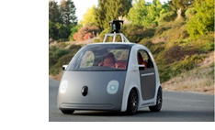




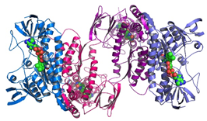



Deep Learning：Heart of Future Applications
Unmanned Vehicle
Speech & Audio
Text & Language
Genomics
Image & Video
Multi-media

Slide 3
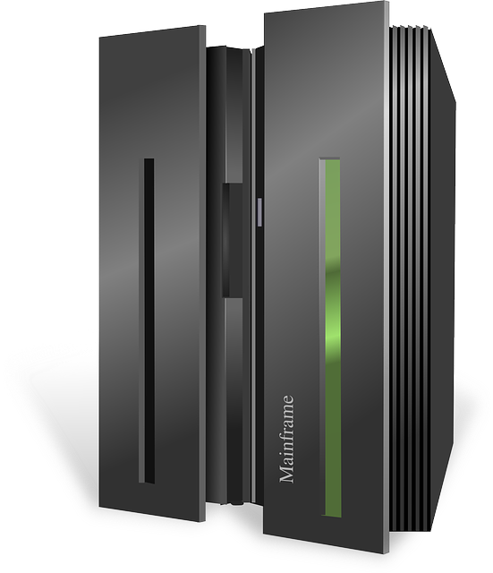

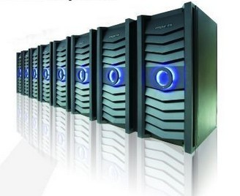
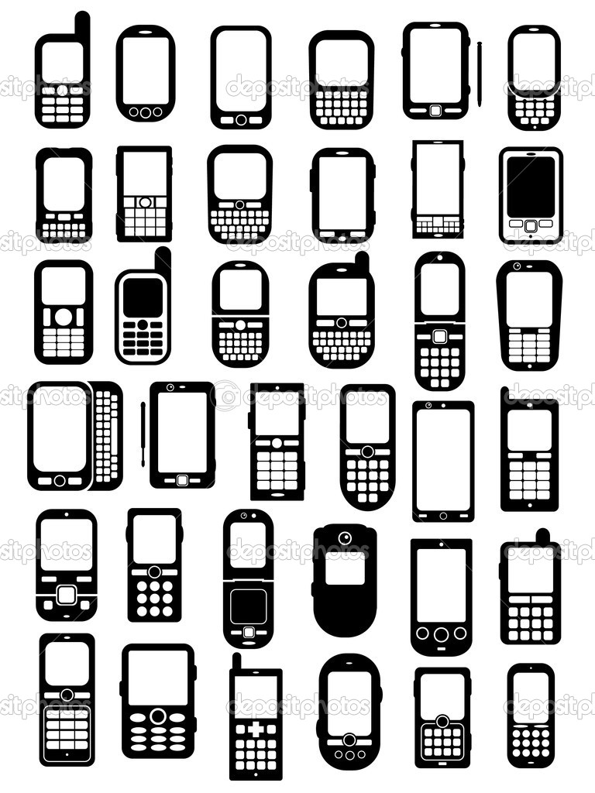


Deep Learning Application Scenarios
Back-end training
Online Processing
— big training data
— big models
— fast iteration
— ~100 high-end GPUs
Intelligent Device
— billions requests/day
— critical cost & power demands
— on forward stage
— ~10,000 CPUs+Accelerators
— real-time response
— critical cost & power demands
— on forward stage
Notes:
Deep learning algorithms are used everywhere. But, we think, they are deployed in 3 stages.
The first stage is called back-end training, in which a large amount of data are fed to deep learning algorithms to let it learn data patterns automatically.
It usually contains a huge amount of computation workload. So those servers are usually equipped with tens to hundreds of high end GPUs.
The second stage is called online processing. A cloud server usually contains tens of thousands servers to processing online data, like image search engines.
Because of data center’s requirement on power budget and low-latency computing, a large amount of accelerators are required in this level.
The last level is called embedded or intelligence device.
Our work is mainly focused on accelerating deep learning’s online processing.

Slide 4
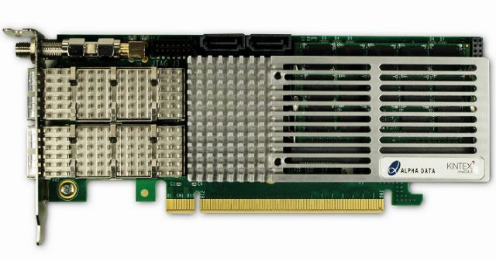
FPGA-based Accelerator in Data Center
CPU
Interconnect
FPGA
CPU
FPGA
Applications (with CNNs)
Our Work
Customized Accelerator
High-level Network Description
Computation Model Optimization for Customized Platforms
Our Work
PCIe
DRAM
Notes:
FPGAs are one of the most promising devices in data center level acceleration. Microsoft recently has deployed 10k FPGA devices on its bing search ,and Azure cloud server.
In our work, we assume each cloud server is equipped with one FPGA acceleration board. Each FPGA has one local DRAM and communication with CPU host with PCIe interconnect.
After CPU received requests from user applications, It offloads deep learning computation workload to FPGA device.
The green part is our work, which contains a customized accelerator and corresponding accelerator-specific driver/compiler.

Slide 5
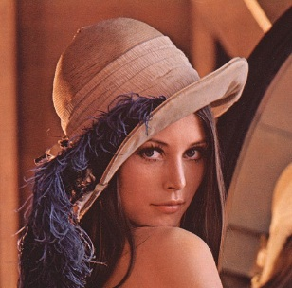

Convolutional Neural Networks (CNNs)
Input Image
Fully connect
Fully connect
Pool
Conv
Conv
Fully connect
ReLU
Conv
ReLU
Conv
ReLU
Conv
ReLU
64
128
$$w_{ij}^{1l}$$
$$w_{ij}^{1l}$$
56
K=3
224
K=5
56
128
3
224
Convolution Layer
Convolution Layer
Notes:
A CNN network has different convolution layers, for example as shown here, two convolution layers are different in number and size of input/output feature maps and shape and stride of weight kernels.

Slide 6
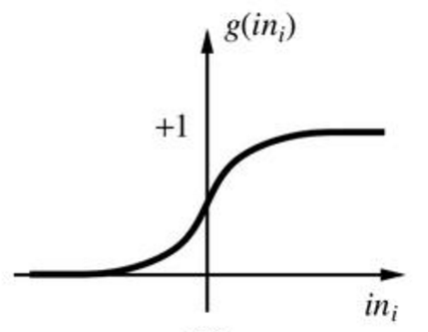
Convolutional Neural Networks (CNNs)
Input Image
Fully connect
Fully connect
Pool
Fully connect
Pool
Conv
Conv
Conv
ReLU
Conv
ReLU
ReLU
Conv
ReLU
Pooling Layer
Non-linear layer
Notes:
A CNN network also have different layers, other than convolution layer, there are pooling layer and non-linear activation layer for feature extraction and fully connected layer for classification.

Slide 7
Challenge 1: Various Convolution Kernel & Layer Configurations
Network definitions (& layer parameters) change according to applications
  CNNs are getting deeper, more precision achieved with deeper network
  Network parameters vary across layers, many user definable parameters
Hardware has limited programmability
  Re-synthesize bitstream for each network? – Not preferred
  Re-program FPGA for each layer? – No!
152 layers
Error Rate
28.2
25.8
16.4
11.7
19 layers
22 layers
7.3
6.7
shallow
8 layers
8 layers
3.57
Notes:
There are many challenges in designing deep learning accelerators. First of all, there are various convolution kernels with different layer configurations.
As shown here, from 2010 to 2016, lower error rate and higher precision are achieved as CNN networks are getting deeper, that is, having more layers. Not say, network parameters vary across different CNN networks and different layers within one CNN network.
As algorithm changes, the hardware, however, has limited programmability. Shall we re-synthesize bitstream for each network? This is not preferred because synthesizing FPGA bitstream takes hours of effort.
And shall we re-program FPGA for each layer? This is also not a good choice because the latency requirement for online processing jobs and we could not afford latency in the reprogramming for each layer.

Slide 8
Challenge 2: Various Computation Patterns
Convolution layer & Fully connected layer
  Convolution layer -- Compute Intensive
  Fully Connected layer -- Communication Intensive
Hardware has limited bandwidth resource
  Convolution layer -- extensive previous study
  Fully connected layer -- How to maximize bandwidth utilization?
  CONV + FCN -- How to re-use hardware for both kernels?
 | CONV | POOL | ReLU | FCN
Mega float Op. | 3x10⁴ (99.5%) | 6 (0%) | 14 (0%) | 1.2x10² (0.4%)
Feature map +weights size (MB) | 113 (19.3%) | 0 (0%) | 0 (0%) | 471.6 (80.6%)
Time% in pure software | 96.3% | 0% | 0% | 3.7%
after CONV acceleration | 48.7% | 0% | 0% | 51.2%
Mega float Operations | 3x10⁴ (99.5%) | 6 (0%) | 14 (0%) | 1.2x10² (0.4%)
Feature map +weights size (MB) | 113 (19.3%) | 0 (0%) | 0 (0%) | 471.6 (80.6%)
Notes:
The second biggest challenge is that CNN layers have different computation and communication patterns.
Convolution layer and Fully connected layer are two major layers in CNN. CONV layer and FCN present two extreme features. As shown in the table here, CONV layer are very computation intensive, it takes 19% total data but need 99% computation. In contrast, FCN layer in the last column, are communication intensive. They need 0.4% of arithmetic operations but use 80% of the total data. These two layers occupy more than 99.9% of the total execution time.
As hardware has limited bandwidth resource, how we can maximize bandwidth utilization for FCN layer and how to accelerate both the CONV and FCN layer on one accelerator need to be solved.

Slide 9
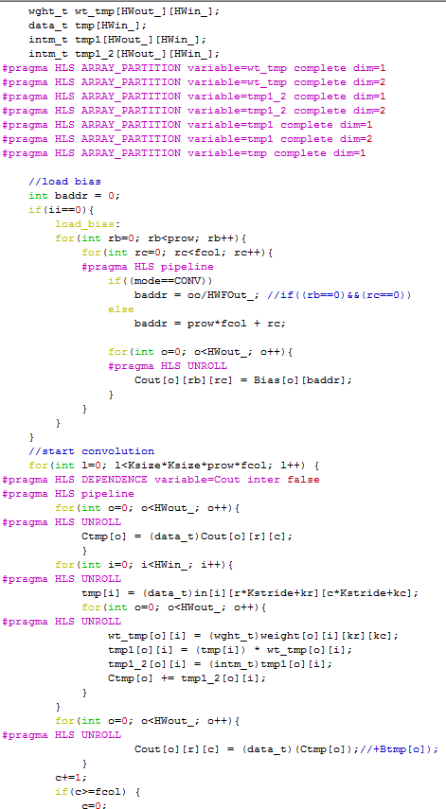
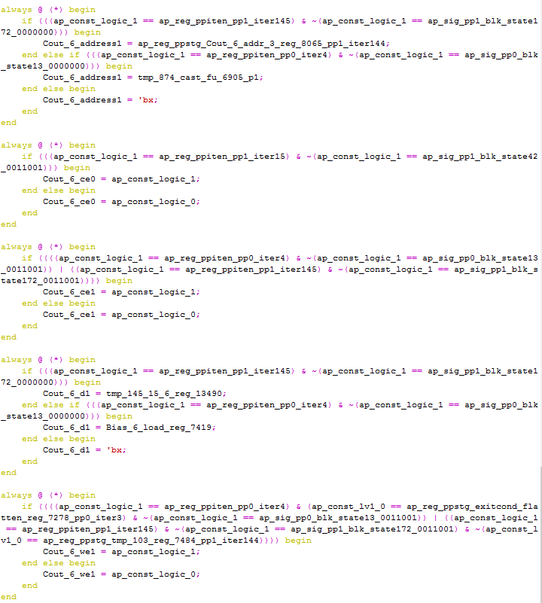

Challenge 3:
Hardware is very hard for software programmer
10 lines of Caffe Code
600 lines of HLS Code
10,000 lines of Verilog
layers {
bottom: "conv1_1"
top: "conv1_2"
name: "conv1_2"
type: CONVOLUTION
convolution_param {
num_output: 64
pad: 1
kernel_size: 3 }
}
layers {
bottom: "conv1_2"
top: "pool1"
name: "pool1"
type: POOLING
pooling_param {
pool: MAX
kernel_size: 2
stride: 2 }
}
Harder
Harder
Notes:
The third challenge is that hardware accelerator design is hard for software programmer to deploy.
A software programmer only need around 10 lines of Caffe code to define a CNN network, however, this corresponds to 600 lines of HLS C code to design FPGA accelerator. And furthermore, this corresponds to 10,000 lines of RTL Verilog code. How to let software programmer to use hardware accelerator easily also need to be addressed.

Slide 10
Challenges & Our Solutions
High-level Network Definitions
Challenge 3: Hardware is very hard for software programmer
Automation flow
CONV
FCN
POOL
ReLU
Challenge 1:
Various Convolution Kernel & Layer Configurations
Uniformed Representation
Challenge 2: Performance Optimization
Software Definable
FPGA-based Accelerator Design
1. Re-use same hardware for both CONV&FCN
2. Deal with both computation & bandwidth bound kernels
Computation Optimization
Bandwidth Optimization
Notes:
In this way, we propose Caffeine, that is, Caffe FPGA engine, to address these issues.
For challenge 1, that is, CNN have various convolution kernels and layer configurations. We propose a uniformed representation for both convolution and fully connected layers.
We further made our FPGA-based accelerator design according to this uniformed representation.
For challenges 2, that is, CONV&FCN kernel’s have different computation and communication pattern, we design hardware for both CONV and FCN, and we do optimizations to maximize both computation operations and bandwidth.
For challenge 3, that is, efforts in deployment of FPGA-based CNN accelerator, we made an automation flow for application –level users to use our accelerator. A standard caffe programming language is all users need to know to program our FPGA accelerator.

Slide 11
Caffeine
Software/Hardware Co-designed FPGA-based deep learning library
Caffe framework
Network definitions (feedforward)
Layer definitions
Automation flow
CONV
FCN
POOL
ReLU
CONV
FCN
POOL
ReLU
Uniformed Representation
Our work
MKL, BLAS
cuDNN
CPU_forward
GPU_forward
FPGA-based Accelerator Design
Computation Optimization
Bandwidth Optimization
Notes:
And Caffeine is the software/hardware co-designed FPGA-based deep learning library, We integrate Caffeine with industry standard Caffe deep learning framework. As shown in this figure, our work caffeine is in the same level as other GPU or CPU based deep learning library, including cuDNN on GPU or Intel MKL.

Slide 12
Automation Flow: From Caffe to Hardware
CNN Layer Definitions
input: "data"
input_dim: 3
input_dim: 224
input_dim: 224
layers {
bottom: "conv1_1"
top: "conv1_2"
name: "conv1_2"
type: CONVOLUTION
convolution_param {
num_output: 64
pad: 1
kernel_size: 3 }
}
layers {
bottom: "conv1_2"
top: "conv1_2"
name: "relu1_2"
type: RELU
}
layers {
bottom: "conv1_2"
top: "pool1"
name: "pool1"
type: POOLING
pooling_param {
pool: MAX
kernel_size: 2
stride: 2 }
}
Customized Accelerator Instructions
Type | input | output | row | col | kernel | stride | pad | ReLU | POOL | size | stride
CONV/FCN | 3 | 64 | 224 | 224 | 3 | 1 | 1 | 1 | 1 | 2 | 2
Notes:
Let’s first look at the automation flow from Caffe to hardware. The CNN layer definition in prototxt file are translated to customized accelerator instructions and we will explain later how these instructions are loaded to instruction cache in Caffeine accelerator.

Slide 13
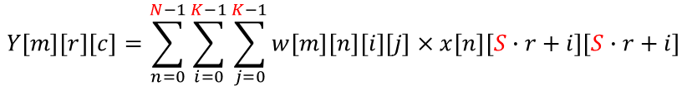
Convolution Layer
$$w_{11}^{11}$$
$$w_{12}^{11}$$
M
$$w_{21}^{11}$$
$$w_{22}^{11}$$
$$w_{11}^{12}$$
$$w_{12}^{12}$$
$$w_{ij}^{1l}$$
$$w_{21}^{12}$$
$$w_{22}^{12}$$
$$w_{11}^{13}$$
$$w_{12}^{13}$$
R
$$w_{21}^{13}$$
$$w_{22}^{13}$$
K
K
$$w_{11}^{14}$$
$$w_{12}^{14}$$
$$w_{21}^{14}$$
$$w_{22}^{14}$$
N
K
C
$$Y\left[m\right]\left[r\right]\left[c\right]=\sum_{n=0}^{N−1}{\sum_{i=0}^{K−1}{\sum_{j=0}^{K−1}{w\left[m\right]\left[n\right]\left[i\right]\left[j\right]×x\left[n\right]\left[S∙r+i\right]\left[S∙r+i\right]}}}$$
1 for(row=0; row<R; row++) {
  2 for(col=0; col<C; col++) {
    3 for(to=0; to<M; to++) {
      4 for(ti=0; ti<N; ti++) {
      5 for(i=0; i<K; i++) {
      6 for(j=0; j<K; j++) {
output_fm[to][row][col] += weights[to][ti][i][j]*input_fm[ti][S*row+i][S*col+j];
}}}}}}
R, C, M, N, K, S are all configuration parameters of the convolutional layer
Notes:
Convolution layer in CNN is a 6-for loop computation kernel, where row size R, column size C, input and output feature number N, M, and kernel and stride size K, S are all configuration parameters of the convolution layer.

Slide 14
Data Tiling and Loop Pipelining
1 for(row=0; row<R; row+=Tr) {
  2 for(col=0; col<C; col+=Tc) {
    3 for(to=0; to<M; to+=Tm) {
      4 for(ti=0; ti<N; ti+=Tn) {
5 for(trr=row; trr<min(row+Tr, R); trr++) {
  6 for(tcc=col; tcc<min(tcc+Tc, C); tcc++) {
    7 for(too=to; too<min(to+Tm, M); too++) {
      8 for(tii=ti; tii<(ti+Tn, N); tii++) {
      9 for(i=0; i<K; i++) {
      10 for(j=0; j<K; j++) {
output_fm[to][row][col] += weights[to][ti][i][j]*input_fm[ti][S*row+i][S*col+j]; }}}}}}
Partitioned Data Stored in DRAM
Off-chip Data Transfer: Memory Access Optimization
On-chip Data: Computation Optimization
Tr, Tc, Tn, Tm
Constrained by DSP, BRAM resources &
Definable Parameters for Parallelism and Caching
Chen Zhang, Peng Li, Guangyu Sun, Yijin Guan, Bingjun Xiao and Jason Cong, " Optimizing FPGA-based Accelerator Design for Deep Convolutional Neural Networks", International Symposium on Field-Programmable Gate Arrays (FPGA), 2015
Notes:
But we cannot run this code directly on FPGA. The input and output feature map size is out of BRAM capacity.
We need to tile loops so that we can host only a portion of data on chip.
We do the loop tiling transformation and this is the tiled loop.
Pls don’t be bothered by the lines. And we can focus on yellow and green block here.
As shown here, the inner 6 loops, in the yellow region, are point loops and are for on-chip data computation. Here the tiling loop boundary, Tr, Tc, Tn, Tm, correspond to tiling size in row, column and input/output feature map size. These are limited by DSP, BRAM resources on FPGA.
The outer 4 loops, in the blue rectangle, are tile loops for transferring new tiles of data.
We will discuss them separately at first and then I will show you how to build models for the co-optimization.

Slide 15
Mapping Convolution to Accelerator
A Convolution Layer
<4 input feature maps, 4 output feature maps>
A CNN Layer Accelerator
<2 input buffers, 2 output buffers>
Notes:
Let’s look at how we map convolution layer to hardware accelerator. For example, we have a convolution layer that have 4 input feature maps and 4 output feature maps. And The CNN accelerator have only two input buffers and 2 output buffers. In this case there are 2 by 2, in total 4 weight buffers.

Slide 16
Mapping Convolution to Accelerator
A Convolution Layer
A CNN Layer Accelerator
Notes:
And input buffer and output buffer size on chip is limited by BRAM resource, in addition to tiling on input and output feature maps, we have to do tiling along row and column direction. In the first set of tiles, part of the first two input feature maps are loaded into input buffer, and corresponding 4 weight kernels are loaded into weight buffers. The accelerator compute part of the first two output feature maps.

Slide 17
Mapping Convolution to Accelerator
A Convolution Layer
A CNN Layer Accelerator
Notes:
In the second tile, part of the third and four input feature maps and corresponding weight kernels are loaded to input and weight buffers and the output are added to the output files

Slide 18
Mapping Convolution to Accelerator
A Convolution Layer
A CNN Layer Accelerator
Notes:
The third set of tiles slide along the column direction of first two input feature maps and corresponding output are computed

Slide 19
Mapping Convolution to Accelerator
A Convolution Layer
A CNN Layer Accelerator
Notes:
And in the fourth set of tiles, tiles from the third and four input features maps and weight kernels are loaded and results are added back to the output buffers. And these tiled computation goes on until the all the input maps and weight tiles are loaded and all the output feature maps are computed.

Slide 20
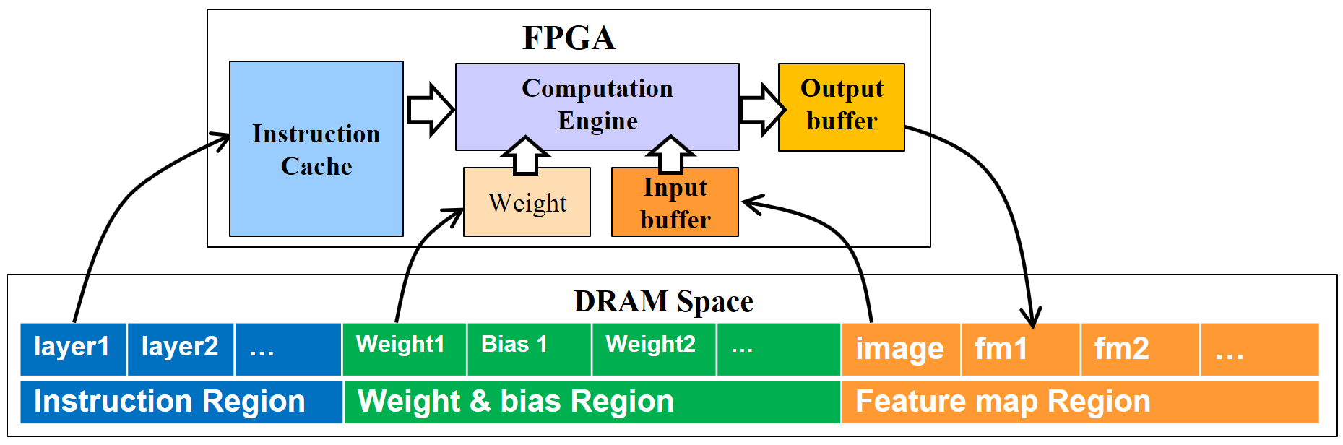
Start by loading First Instruction (Layer 1)
1
2
layer1
layer2
1
2
3
1
2
3
Load Weight (tile 1) & Image (tile 1)
Load Weight (tile 2), Image (tile 2) & Store Output (tile 1)
Load Weight (tile 3) & Image (tile 3) & Store Output (tile 2)
……………………………… Until layer 1 finishes
Start to load second instruction (Layer 2)
Notes:
In summary, the execution of Caffeine accelerator works as shown in the figure. In the first phase, FPGA loads the bitstream and gets programmed, the customized instructions that specify the CNN layer definition and weight data and input data are written into FPGA DRAM space. This is done only once and the FPGA is programmed only once. In the second phase, Caffeine conducts the CNN acceleration, it starts with loading the instruction of layer1 into instruction cache on chip, and load in weight data and input feature map data of tile 1 on chip from DRAM, After accelerator computation, the output feature map of tile 1 is computed and written back to dram space. At the same time, weight and input feature map of second tile are loaded. And same thing goes on, when we load the third tile from dram space, we store the output of the second tile back to DRAM. And this tile pipeline goes until layer 1 finishes. And the second layer is computed in a similar way as layer 1.

Slide 21
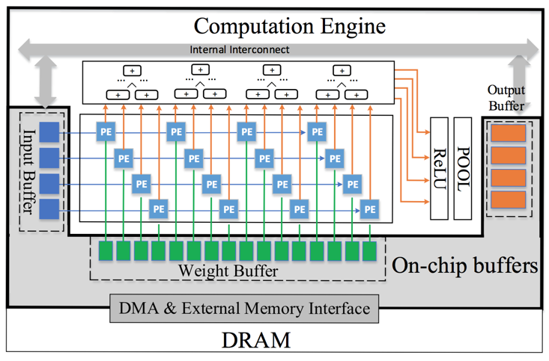
Accelerator Architecture Design
Notes:
This is the detailed view of our FPGA based accelerator. We can discuss more about it afterwards.

Slide 22
Fully Connected Layer:
Communication Intensive, Much More Than Convolution
Largest Convolution Layer in VGG
input | output | row | col | kernel | stride | Mega Floating Operations | Input + output + weight size (MB) | Comp/Data Ratio
64 | 64 | 224 | 224 | 3 | 1 | 3700 | 6.16 | 600.3
Largest Fully Connected Layer in VGG
input | output | - | - | - | - | Mega Floating Operations | Input + output + weight size (MB) | Comp/Data Ratio
25088 | 4096 | - | - | - | - | 2100 | 98 | 21.4
Notes:
As discussed before, Fully connected layer is communication intensive and very sensitive to off-chip bandwidth. For example, In the largest convolution layer in VGG network, if we calculate the comp/data ratio, that is, total computation operations over total data size, convolution layer is around 600, while fully connected layer is only 21. Higher computation/data ratio means higher data reuse and computation intensive, while lower ratio means communication intensive.

Slide 23
FPGA Bandwidth
much smaller than GPU/CPU (~10 vs. ~200 GB/s)
sensitive to access patterns
                ---- burst length & bit-width
        ---- improper access makes effective bandwidth worse
1KB
16KB
32KB
64KB
128KB
Notes:
Moreover, FPGA bandwidth is around 10GB/s and this is much smaller than GPU/CPU, which is more than 200GB/s,
And what’s worse, FPGA off-chip bandwidth is sensitive to access patterns, including burst length and dram bus bit-widths.
For example, when we set bus bit-width to 512 bits, the effective bandwidth is really small when burst length is only 1KB and the bandwidth increases as we the burst length increases.
When the bus bit-width is smaller like 32 bits and 128 bits, the maximum effective bandwidth is much smaller than that of 512 bits. In summary, improper data access makes FPGA effective bandwidth worse.
And we need to optimize the off-chip bandwidth by increasing burst and using larger bit-width bus.

Slide 24
Mapping Fully Connected Layer to Convolution
Method 1: Input-major Mapping
Fully connected layer
Input
Fully connected layer
Output
Convolution
Input
Convolution
Output
Notes:
To understand how we optimize the FPGA bandwidth for FCN, we first introduce two ways of mapping FCN layer to convolution accelerator, The first one is input-major mapping, On the left, it is FCN computation, while on the right, it is convolution accelerator after FCN is mapped. In inpu—major mapping, we map the input vectors in FCN to input feature map in CONV, and weight matrix of FCN to weight kernels in CONV.

Slide 25
Mapping Fully Connected Layer to Convolution
Method 2: Weight-major Mapping
Fully connected layer
Input
Fully connected layer
Output
Convolution
Input
Convolution
Output
Notes:
The second one is reverse mapping, or weight-major mapping, here, we map the weight matrix in FCN to input feature map of CONV, accordingly, we map input in FCN to weight kernels of CONV.

Slide 26
Method 1: Input-major mapping
Two Ways of Improving Effective Bandwidth
Raw Mapping
1. Batching
2. Merging
Notes:
And for each mapping methods, there are two ways to increase the burst length in transferring data to improve effective bandwidth. The first one is batching the input. We can map a batch of elements from different input vectors in FCN to the same input feature map in CONV, as shown here, we batch 3 input vectors. As a result, the data reuse of weight kernels is improved.
The second one is merging the weight kernel, that is, we could merge groups of input features maps to one input feature map and groups of weight kernels into one weight kernel.
Both ways will increase the burst length and effective off-chip bandwidth.

Slide 27
Method 2: Weight-major Mapping
Two Ways of Improving Effective Bandwidth
Raw Mapping
1. Batching
2. Merging
Notes:
For reverse weight major mapping, similarly, batching input to increase burst length in the weight kernels in CONV and merging input feature maps and weight kernels will increase burst length and effective bandwidth. Batching and merging help improving effective bandwidth for both methods. Furthermore, we will show in the later slides, weight-major mapping make more use of input feature map buffer and is better than input-major mapping in terms of effective bandwidth, even when batch size is 1.

Slide 28
FCN input | FCN weight | FCN output
25088 | 25088 x 4096 | 4096
CONV input buffer | CONV weight buffer | CONV output buffer
32 x 1 | 32 x 32 x 1 | 32 x 1
Input Burst Len | Weight Burst Len | Output Burst Len
32 | 1024 | 32
Iteration Times | Iteration Times | Iteration Times
784 | 100,352 | 128
Batch Size = 1
32
32
25088
4096
Weight:
4096*25088
Notes:
For example, when batch size is 1, and we need to compute FCN layer that has 25k input and 4k output, in total 25k times 4k weight data, And assume that we have CONV accelerator that has 32 input buffers, and 32 output buffers, 32*32 number of weight buffers. After mapping this FCN to CONV accelerator using input-major mapping, in each input buffer, there is only 1 data when batch size is 1, and similarly in each output buffer, there is only 1 data element, And each weight buffer, there is only 1 data element. Assume we could load all input data in 1 bus transfer, then the input and output burst length is 32, and weight burst length is 1024.

Slide 29
FCN Input | FCN Weight | FCN Output
25088 | 25088 x 4096 | 4096
CONV Weight Buffer | CONV Input Buffer | CONV Output Buffer
32 x 1 x 1 | 32 x 4096 | 1x 4096
Input Burst Len | Weight Burst Len | Output Burst Len
32 | 131072 | 4096
Iteration Times | Iteration Times | Iteration Times
784 | 784 | 1
Batch Size = 1
32
32
25088
4096
Weight:
4096*25088
Notes:
However, if we map the same FCN computation in CONV accelerator using reverse mapping, that is, map weight kernel in FCN into CONV input buffers. Since each CONV input buffers are large buffers that can hold up to 7000 data elements, we can store all the weight kernels corresponds to 32 input feature and 4k output feature on chip in the CONV input buffer, that is 32 by 4K. Accordingly, the output for this one batch are stored in one output buffer in CONV accelerator. In this way, the input burst length is still 32, while the weight burst length increases to 131K and output burst length increases to 4K. And this is huge improvement in burst length compared to input-major mapping when batch size is only 1. That is to say, reverse mapping makes more use of buffer size and have higher burst length and off-chip bandwidth compared to input-major mapping.

Slide 30
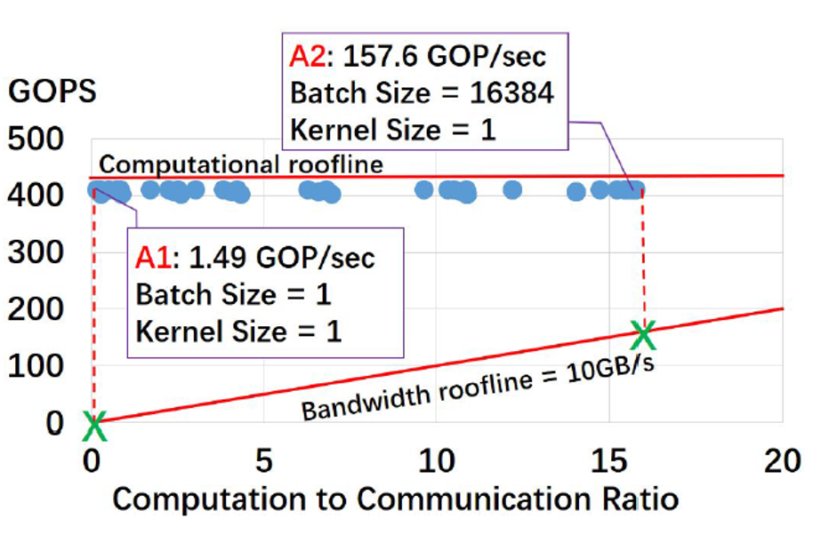
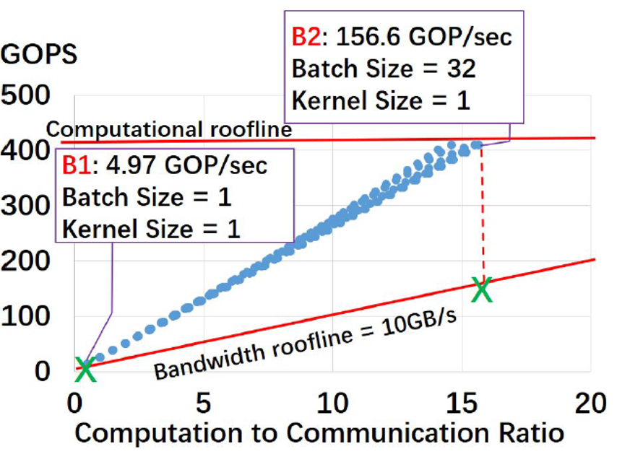
Design Space in Roofline Model
Method 1: Input-major Mapping
Method 2: Weight-major Mapping
Notes:
Here we show the design space exploration when we have different batch sizes and kernel sizes for input-major mapping and weight-major mapping. The X axis is CTC ratio, that is computation to communication ratio, And Y axis is the computation performance. The blue dots here are design points that have different batch sizes and kernel sizes. And there is line that goes through the origin of coordinate here shows the FPGA bandwidth roofline. For a specific FPGA platform, this line has a fixed slope and the slope characterizes the off-chip bandwidth limit. And dots that are above this line cannot achieve the computational roofline and their projection onto the bandwidth roofline is the actual or attainable computation performance.
We can drew two conclusions from the two graphs.
Comparing A1 and B1, we can see B1 weight-major mapping can achieve higher performance because it has better bandwidth performance and data reuse performance.
Comparing A2 & B2 point, we can see both mapping methods can achieve similar performance in terms of the highest attainable Giga Operations per Second, which are 157.6 GOPS and 156.6 GOPs respectively. However, method 1 input-major mapping achieves it on batching size of 16,384 , method 2 weight-major mapping can achieve it on batching size of 32.
In this way, we use reverse mapping for FCN layer onto CONV accelerator and do bandwidth optimization based on reverse mapping.

Slide 31
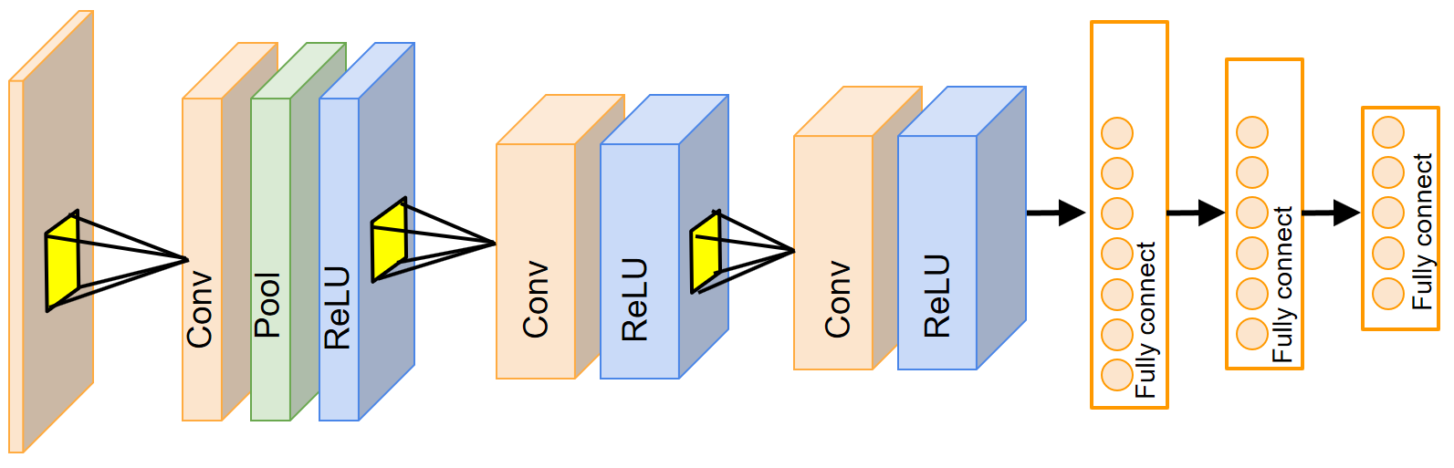
Accelerator-specific VLIW instructions for CNN structures
Type | input | output | row | col | kernel | stride | pad | ReLU | POOL | size | stride
CONV | 3 | 64 | 224 | 224 | 3 | 1 | 1 | 1 | 1 | 2 | 2
CONV | 64 | 64 | 224 | 224 | 3 | 1 | 1 | 1 | 1 | 2 | 2
FCN | 25088 | 32 | 64 | 64 | 1 | 1 | 0 | 1 | 0 | 0 | 0
*.prototxt
*.caffemodel
layers {
bottom: “data"
top: "conv1_1"
name: "conv1_1"
type: CONVOLUTION
convolution_param {
num_output: 64
pad: 1
kernel_size: 3 }
}
layers {
bottom: "conv1_1"
top: "pool1"
name: "pool1"
type: POOLING
pooling_param {
pool: MAX
kernel_size: 2
stride: 2 }
}
layers {
bottom: "conv1_1"
top: "conv1_2"
name: "conv1_2"
type: CONVOLUTION
convolution_param {
num_output: 64
pad: 1
kernel_size: 3 }
}
Conv1_1[64][3][3][3] = {
1.23, -0.3, 1.1, 0.123,
0.43, -1.4, 2.1, -2.133, …
}
Bias1_1[64][3][3][3] = {
0.123, 1.13, 2.11, -0.133,
0.43, -1.4, -0.3, 1.1, …
}
Conv1_2[64][64][3][3] = {
3.21, 0.988, 0.889, 0.31,
2.33. -125.3, 0.765, 1.23 …
}
Bias1_2[64][3][3][3] = {
1.23, 10.123, -0.13, 12.1,
1.1, -2. 3, 0.443, -11.4, …
}
Conv2_1[128][64][3][3] = {
0.21, 0.198, 0.892, 1.31,
3.23. -1.23, 50.2, 0.23 …
}
Bias2_1[64][3][3][3] = {
1.23, -0.3, 1.1, 0.123,
0.43, -1.4, 2.1, -2.133, …
}
Tiling & Reorderring
Accelerator-specific Data Tiling & Layout Re-organization
data_type* DRAM_DATA = (data_type *)malloc(sizeof(all_weights));
DRAM_DATA[] = {1.23, -0.3, 1.1, 0.123, 0.43, -1.4, 2.1, -2.133, …, 0.123, 1.13, 2.11, -0.133, 0.43, -1.4, -0.3, 1.1, …, 3.21, 0.988, 0.889, 0.31, 2.33. -125.3, 0.765, 1.23 …, 1.23, 10.123, -0.13, 12.1, 1.1, -2. 3, 0.443, -11.4, …,0.21, 0.198, 0.892, 1.31, 3.23. -1.23, 50.2, 0.23 …, 1.23, -0.3, 1.1, 0.123, 0.43, -1.4, 2.1, -2.133, …1.23, -0.3, 1.1, 0.123, 0.43, -1.4, 2.1, -2.133, …, 0.123, 1.13, 2.11, -0.133, 0.43, -1.4, -0.3, 1.1, …, 3.21, 0.988, 0.889, 0.31, 2.33. -125.3, 0.765, 1.23 …, 1.23, 10.123, -0.13, 12.1, 1.1, -2. 3, 0.443, -11.4, …,0.21, 0.198, 0.892, 1.31, 3.23. -1.23, 50.2, 0.23 …, 1.23, -0.3, 1.1, 0.123, 0.43, -1.4, 2.1, -2.133, …};
Tiling & Reorderring
Tiling & Reorderring
Written into FPGA DRAM through PCIe
Tiling & Reorderring
Written into FPGA DRAM through PCIe
Tiling & Reorderring
Notes:
Let’s look the automation flow with optimization on both computation and communication.
Upper right corner figure shows a CNN network.
In Caffe framework, each network is defined by two files. 1) prototxt file to define network structures; 2) caffemodel file to define weights&bias value in each layer.
Our automation flow
Starts from transforming network defined in high-level caffe standard files into our accelerator-specific instructions, and these instructions are written into FPGA’s DRAM space
Then we extracts weights & biases from caffemodel file, and transform them according to our optimization, after tiling and data reordering, the data are written into FPGA’s DRAM space.
This is done only once, and then the accelerator computes layer by layer until all the layer computation is finished.

Slide 32
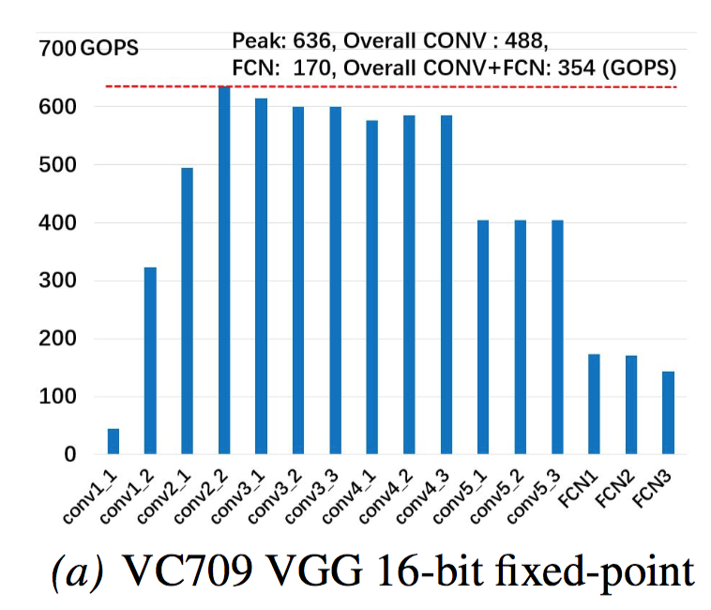
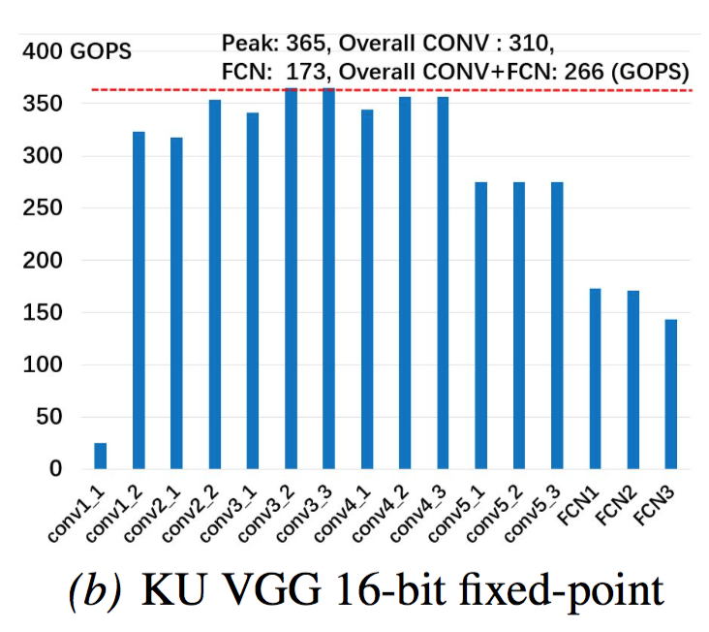
Throughput of Each Layer (1/2)
VC709 & Ku060, VGG
Notes:
We setup our experiment on different FPGA boards including Xilinx VC709 board and KU060 boards. For VGG network, the performance of each CONV and FCN layers are shown here. For VC709, the peak performance is 636 gega operation per second for CONV layer and 170 for FCN. The overall performance is 354 GOPS. And for KU board, the peak performance is 365 for CONV layer and 173 for FCN layer. The overall performance is 266 GOPs.

Slide 33
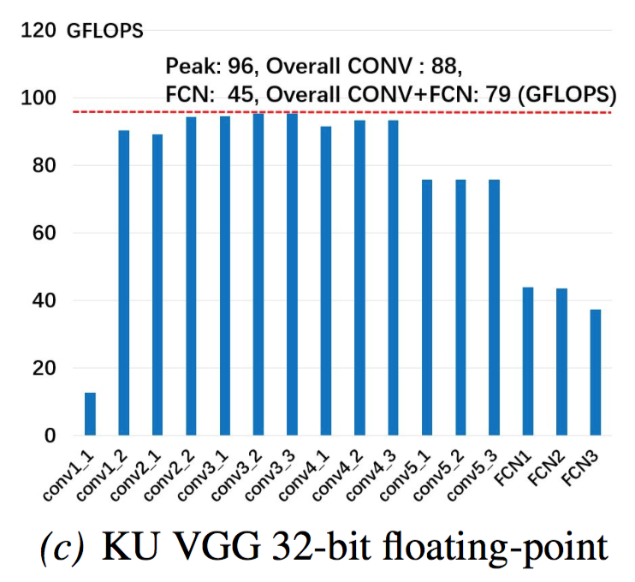
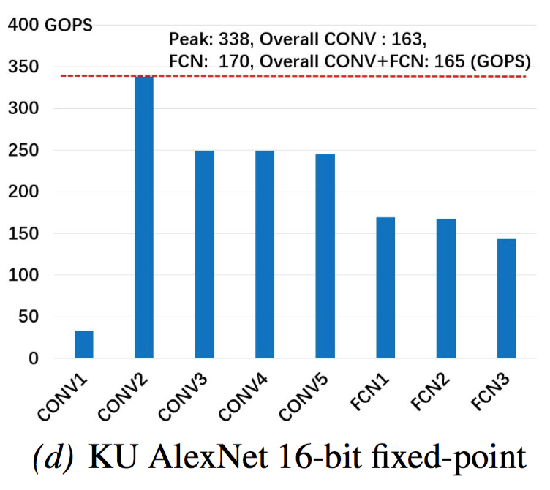
Throughput of Each Layer (2/2)
Ku060, VGG & AlexNet
Notes:
We also use Caffeine to process on different CNN network and different data precision. As shown here, for 32-bit floating operation on KU board, the peak performance is 96 GFLOPs for CONV and 45 GFLOPs for FCN. And for another CNN network, AlexNet, the peak performance is 338 GFOPs for CONV and 170 GFOPs for FCN. In conclusion, Caffeine shows good portability on different FPGA boards, different CNN network and different data types.

Slide 34
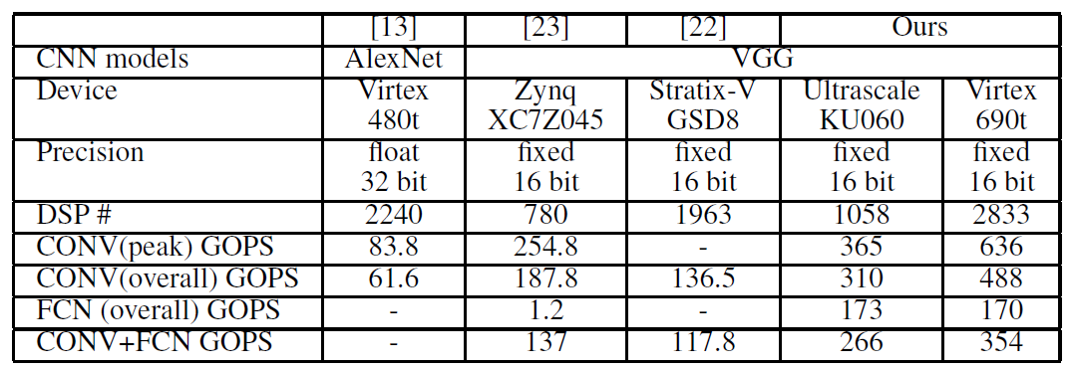
Comparison with Other FPGA Work
[1]
[2]
[3]
DSP # | 2240 | 780 | 1963 | 1058 | 2833
CONV+FCN GOPS | - | 137 | 117.8 | 226 | 354
[1] C. Zhang et al., “Optimizing fpga-based accelerator design for deep convolutional neural networks,” in FPGA. ACM, 2015, pp. 161–170.
[2] J. Qiu et al., “Going deeper with embedded fpga platform for convolutional neural network,” in FPGA. ACM, 2016, pp. 26–35.
[3] N. Suda et al., “Throughput-optimized opencl-based fpga accelerator for largescale convolutional neural networks,” in FPGA. ACM, 2016, pp. 16–25.
Notes:
Compared to other FPGA acceleration work on CNN, our results achieve higher performance on both CONV layer and expecially FCN layer. And the overall CNN accelerator performance are improved in this way.

Slide 35
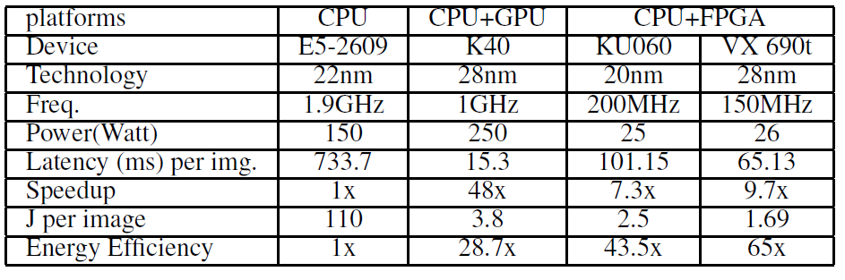
End-to-End Comparison with CPU/GPU Platforms
Energy-efficiency (J/img) | 1x | 28.7x | 43.5x | 65x
Notes:
And compared to CPU or GPU platforms, Caffeine shows around 10x speed up compared to CPU, while achieves higher energy-efficiency than GPU platforms.

Slide 36
Conclusion
Caffeine provides uniformed representation adapted for efficient FPGA acceleration of both CONV and FCN layers, and weight-major mapping is applied to FCN layer.
Caffeine is HW/SW co-designed and reusable FPGA accelerators, where both computation and bandwidth resource utilization are maximized.
Caffeine (CAFfe Fpga EngINE) is the first published attempt to incorporate FPGAs into industry-standard deep learning framework Caffe.

Slide 37
Acknowledgments
Supported by Center for Domain-Specific Computing at UCLA under Intel Award 20134321 and NSF CCF Award 1436827 and C-FAR, one of the six centers of STARnet, a Semiconductor Research Corporation program sponsored by MARCO and DARPA. We also thank UCLA/PKU Joint Research Institute, Chinese Scholarship Council and AsiaInfo Inc.

Slide 38
Q & A
Posters in Workshop HALO ( Hardware and Algorithms for Learning On-a-chip) on Nov 10th, Thursday, afternoon 2:45 PM.

Slide 39
Backup Materials

Slide 40

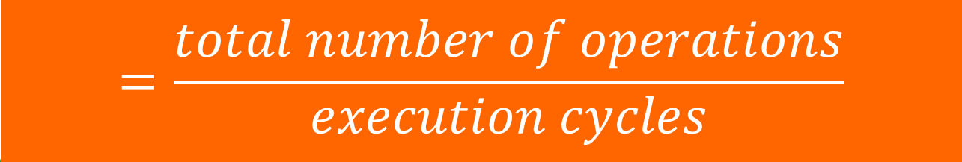
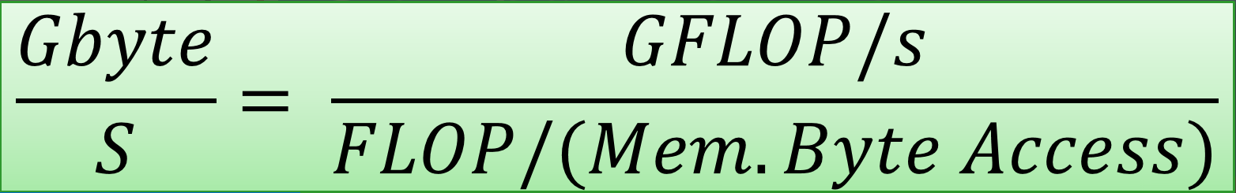
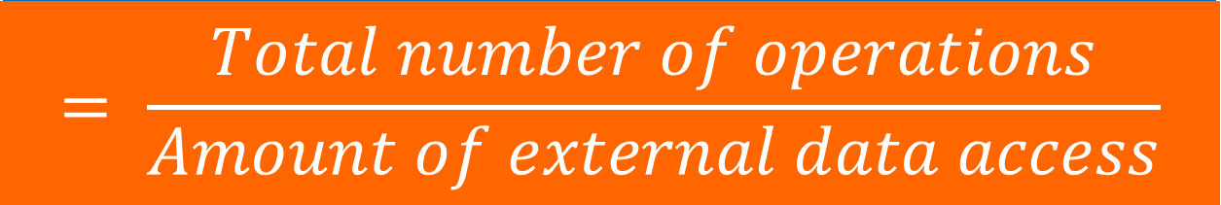
FPGA Design in Roofline Model
Computational Perf.
GFLOP/S
GFLOP/S
Design
Computation To Communication Ratio
Computational Performance
Bandwidth
FLOP / (Mem. Byte Access)
FLOP/(Memory byte access)
Bandwidth
Computation To Communication (CTC) Ratio
Gbyte/S
Notes:
为了完成以上三种资源的共同优化，我们定义了三个 term；
有了这三个term，我们就可以设定一个坐标系，X-axis是 computation to communication ratio；Y-axis是Computational Performance；
任何一个Design只要估计出这两个值就可以在坐标系中找到一个位置。
这条线的斜率是这个design的bandwidth需求。

Slide 41
Attainable Performance
GFLOP/S
Computation
Bandwidth Roof
Computational Roof
Communication
1
Computation
Communication
B
2
3
Computational Performance
Attainable Performance
X
Compt. Perf. (2 & 3 < 1)
A
Attain. Perf. (2 & 3 > 1)
FLOP/(DRAM byte access)
Computation To Communication (CTC) Ratio
Notes:
Assume that we have three different designs, design 1, 2 and 3. They have different attributes of computation performance and CTC ratio.
From the coordinate, we can get that design 1 has higher computational performance than design 2 and 3. So does that mean design 1 is better than design 2 and 3?
Not necessarily.
We need to consider the constraints. Computational roof, max computational performance that the chip and provide. Bandwidth roof, max external bandwidth that the board can support.
Design 1 is located at the left-side of bandwidth roof which means that it has higher bandwidth requirement than what the hardware can support. So its performance is actually bounded by bandwidth. We define this performance as the attainable performance. From this, we can see design 2 and 3’s performance is actually higher than design 1.

Slide 42
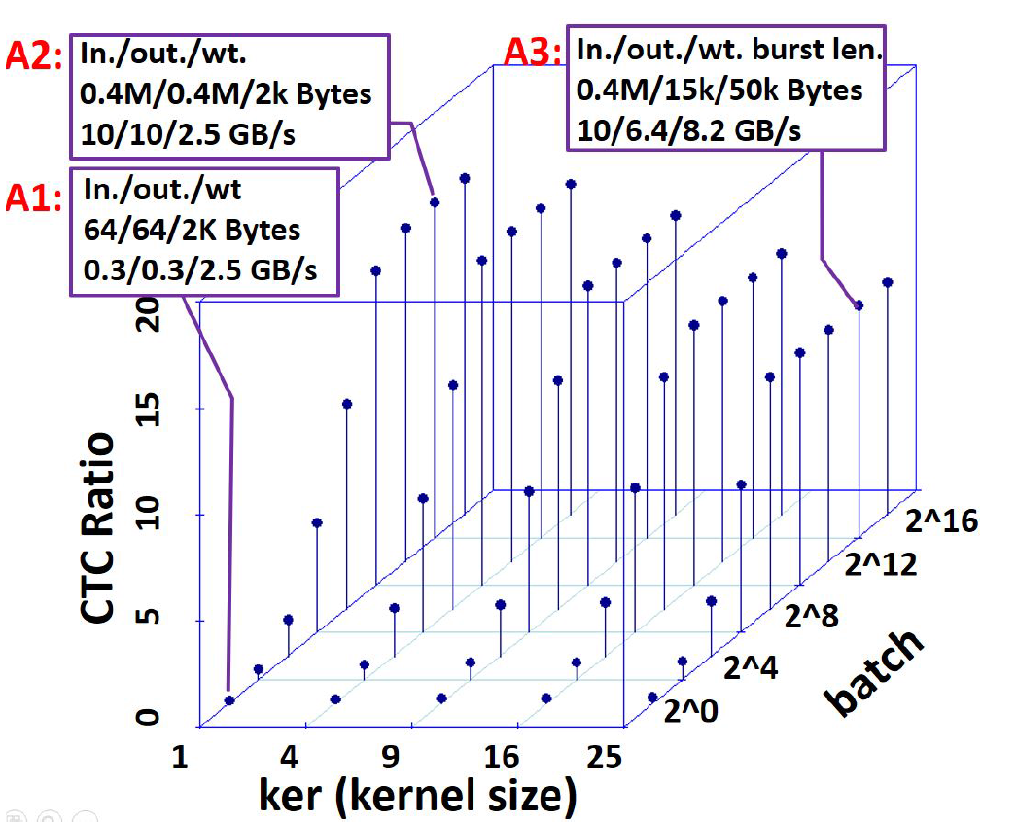
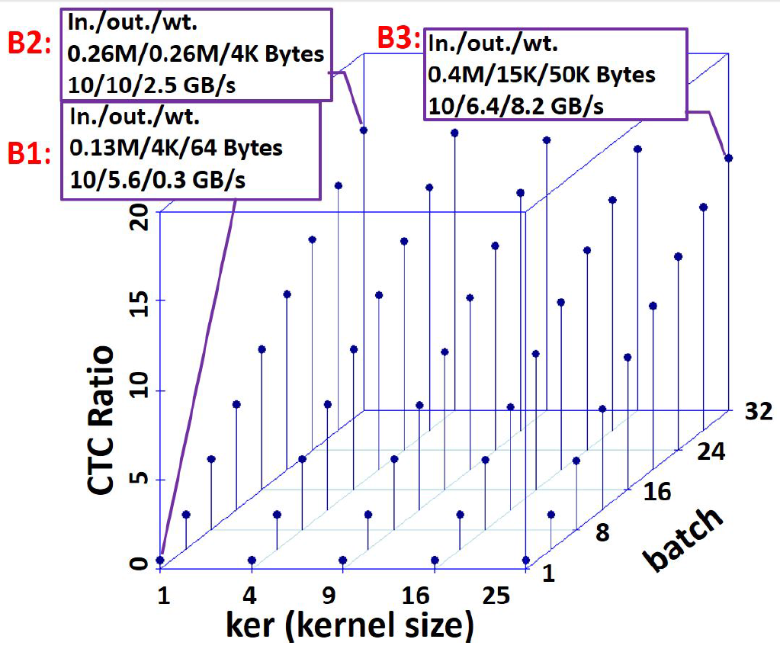
Data Re-use and Bandwidth Improvement
With Respect to “batch” & “kernel size”
Method 1: Input-major Mapping
Method 2: Weight-major Mapping

Slide 43
Mapping Fully Connected Layer to Convolution
Method 1: Input-major Mapping
Fully connected layer
Input
Fully connected layer
Output
Convolution
Input
Convolution
Output

Slide 44
Batch # | FCN input | FCN weight | FCN output
1 | 25088 | 25088*4096 | 4096
Input Size | CONV input | CONV weight | CONV output
6780 | 32 | 32 x 32 | 32
Size in each iter | Iteration Times | Iteration Times | Iteration Times
1 | 784 | 100352 | 128
Size = 3x3
32*32
32
6780
6780
32
25088
4096
32
6780
6780
32
Weight:
4096*25088
6780
6780

Slide 45
Mapping Fully Connected Layer to Convolution
Method 2: Weight-major Mapping
Fully connected layer
Input
Fully connected layer
Output
Convolution
Input
Convolution
Output

Slide 46
Batch # | FCN input | FCN weight | FCN output
1 | 25088 | 25088*4096 | 4096
Input Size | CONV weight | CONV input | CONV output
6780 | 32 | 32*6780 | 6780
Size in each | Times | Times | Times
6780 | 784 | 474 | 1
32
Size = 3x3
32*32
6780
6780
32
25088
4096
32
6780
6780
32*6780
Weight:
4096*25088
6780
6780

Slide 47
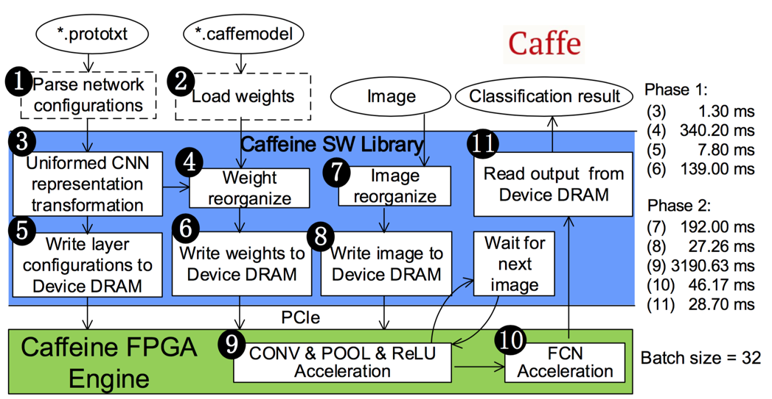
An Automated Flow from Caffe to FPGA
Execute Once for a New Network
Execute Once for a New image
Layer
Configurations
Weights
Images

Slide 48
Software Defined Accelerator with customized instructions, all layers’ instructions cached in DRAM
FPGA
Instruction
Cache
Computation
Engine
Output buffer
Weight
Input buffer
DRAM Space
layer1 | layer2 | …
Weight1 | Bias 1 | Weight2 | …
image | fm1 | fm2 | …
Instruction Region | Weight & bias Region | Feature map Region

Slide 49
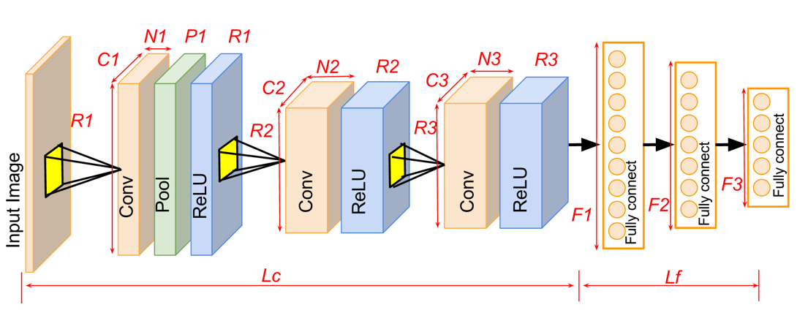
Convolutional Neural Networks (CNNs)
User definable parameters in CNN
Lc | Number of Convolution layers | Lf | Number of fully connected layer
Ci, Ri, Ni | Collumns, Rows of each feature map and Number of feature maps in each layer
Pi, Ri | There is a POOL/ReLU layer following CONV layer or not
Ki, Si | Kernel size and sliding stride of convolution kernel in each layer
Fi | Number of elements in fully connected layer

Slide 50
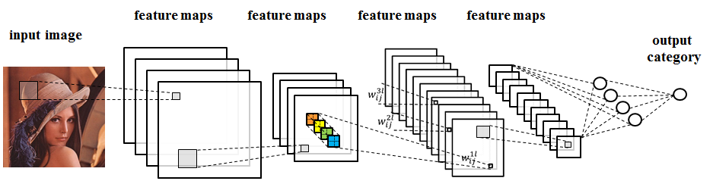
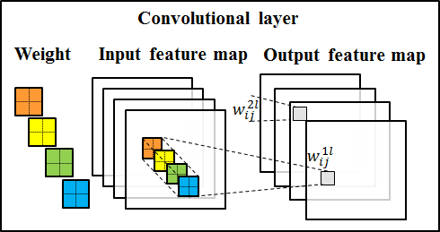
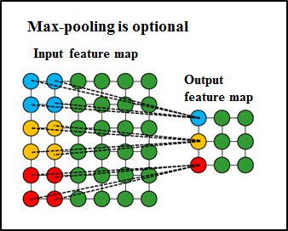
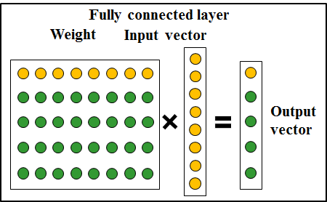
Convolutional Neural Networks (CNNs)

Slide 51
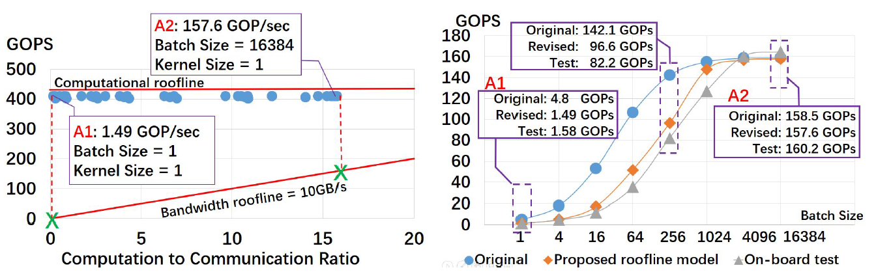
Method 1: Input-major Mapping
Comparison of original, revised roofline models
and on-board test results
Design space in revised roofline model

Slide 52
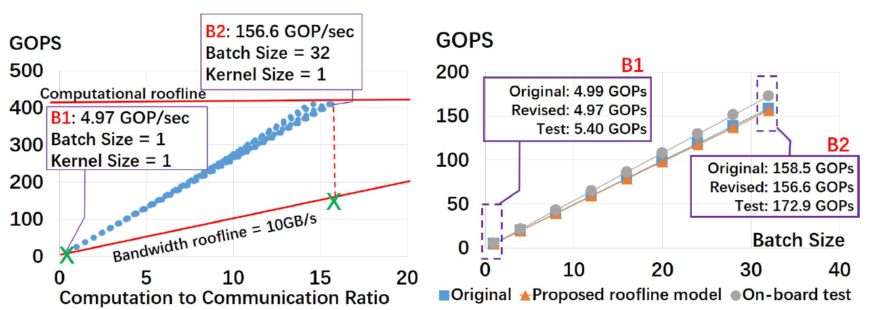
Method 2: Weight-major Mapping
Comparison of original, revised roofline models
and on-board test results
Design space in revised roofline model

Slide 53
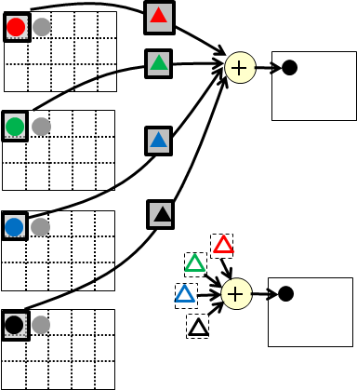
Method 1: Input-major Mapping
Parameters of FCN
Input # | Nfcn
Output # | Mfcn
Batch # | Batch
Parameter Mapped from FCN to CONV
Input feature map # | Nfcn/ker
Input feature map size | Batch * ker
Output feature map # | Mfcn
Output feature map size | Batch
Kernel Size | Ker
Stride | ker
Fully connected layer
Input
Fully connected layer
Output
Convolution
Input
Convolution
Output

Slide 54
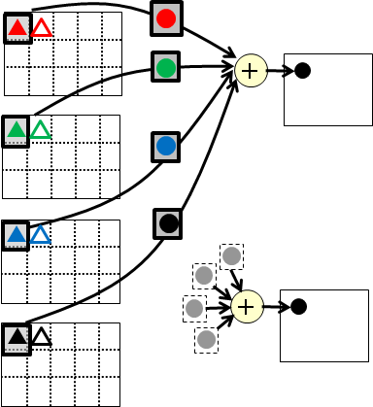
Method 2: Weight-major Mapping
Parameters of FCN
Input # | Nfcn
Output # | Mfcn
Batch # | Batch
Parameter Mapped from FCN to CONV
Input feature map # | Nfcn/ker
Input feature map size | Mfcn * ker
Output feature map # | Batch
Output feature map size | Mfcn
Kernel Size | Ker
Stride | ker
Fully connected layer
Input
Fully connected layer
Output
Convolution
Input
Convolution
Output

Slide 55
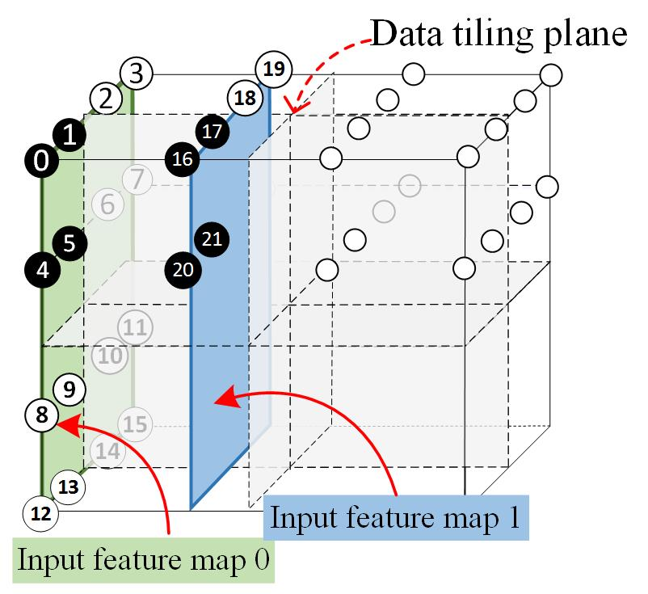
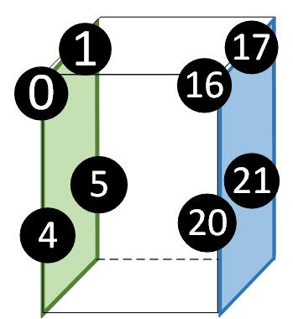

Slide 56
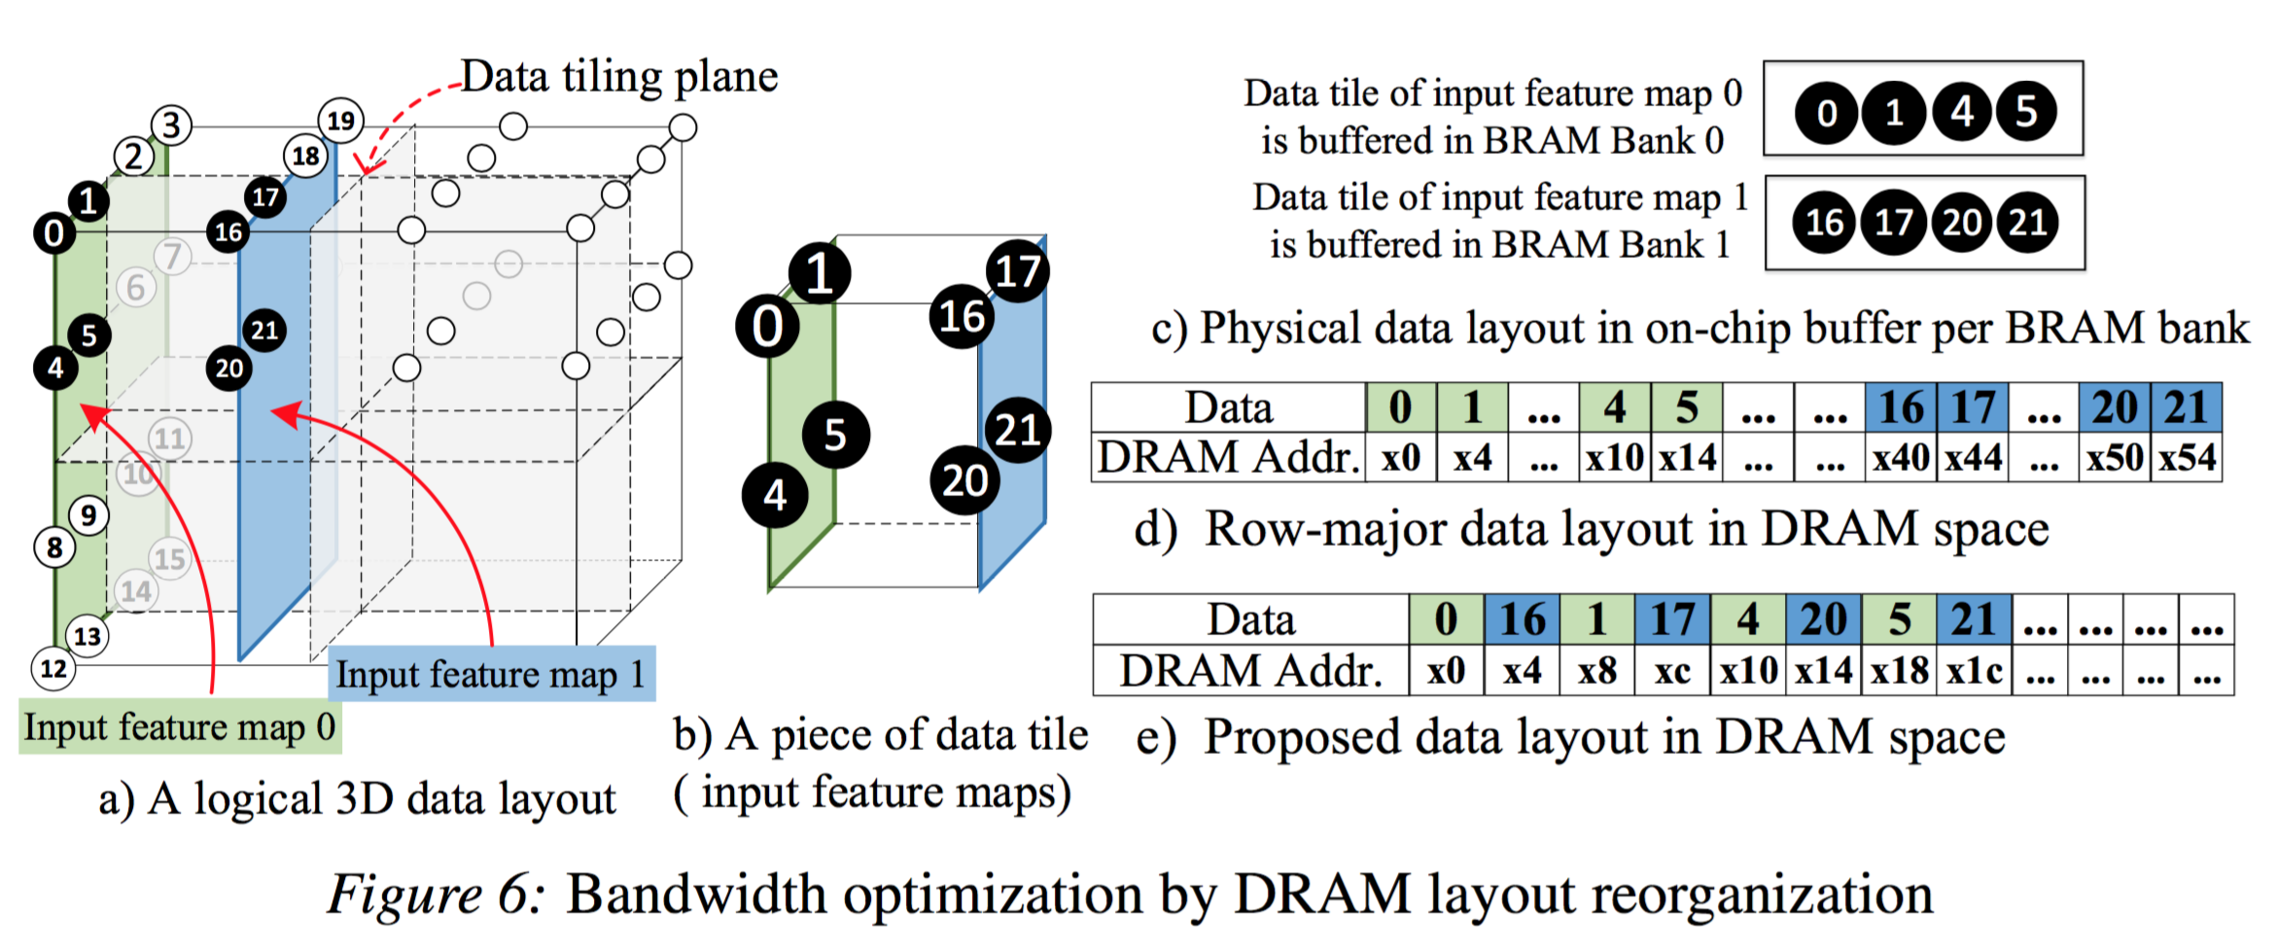

Slide 57
Analysis of Convolution & Fully Connected Layers
Accelerate Convolution & Fully Connected Layer with One Bitstream
  Convolution Accelerator
  Uniformed Representation
Maximize Underlying Computing & Bandwidth Resource
  Computation Optimization
    FPGA 2015 (Loop permutation, unrolling, pipelining)
  Bandwidth Optimization
    Roofline Model

Slide 58
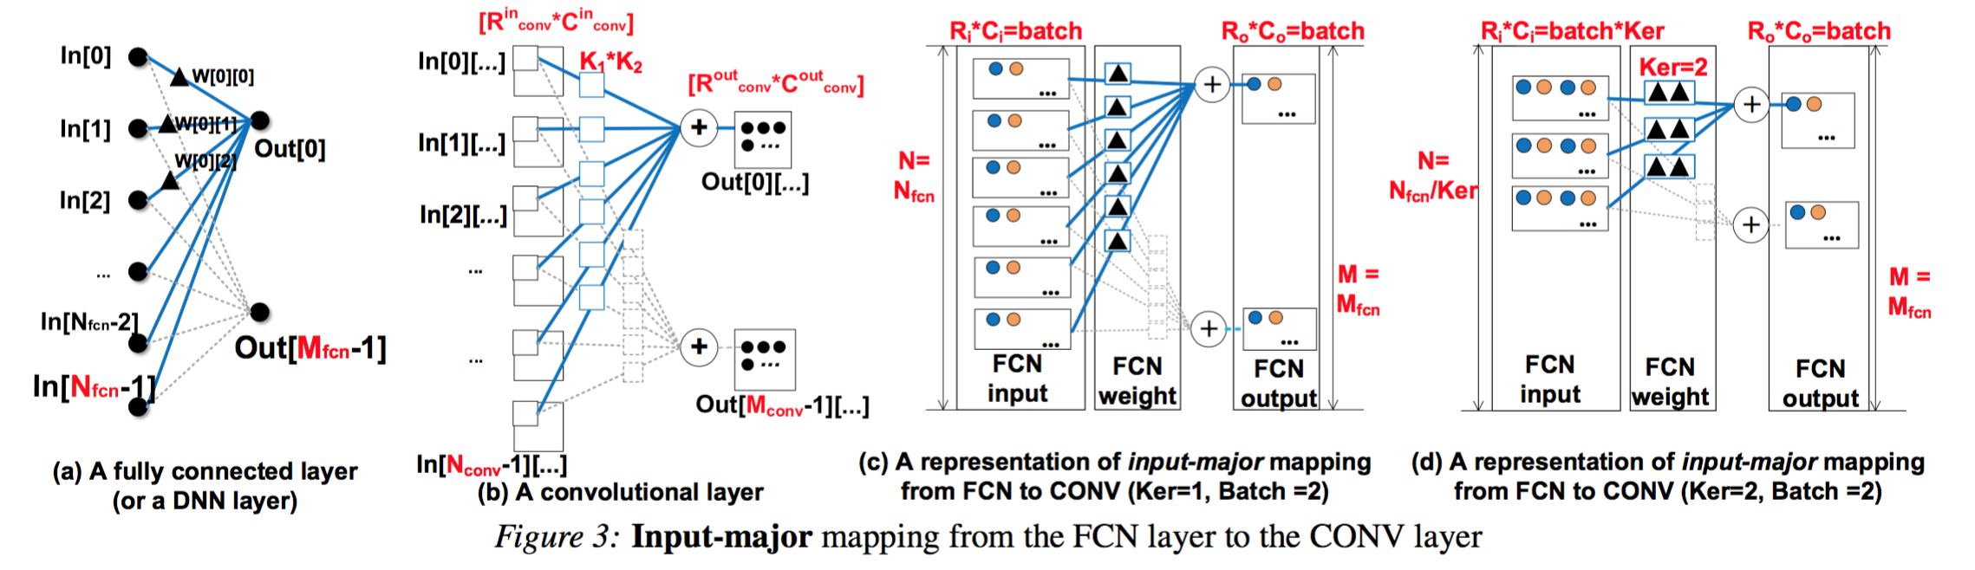
Direct (input-major) Mapping from FCN to CONV

Slide 59
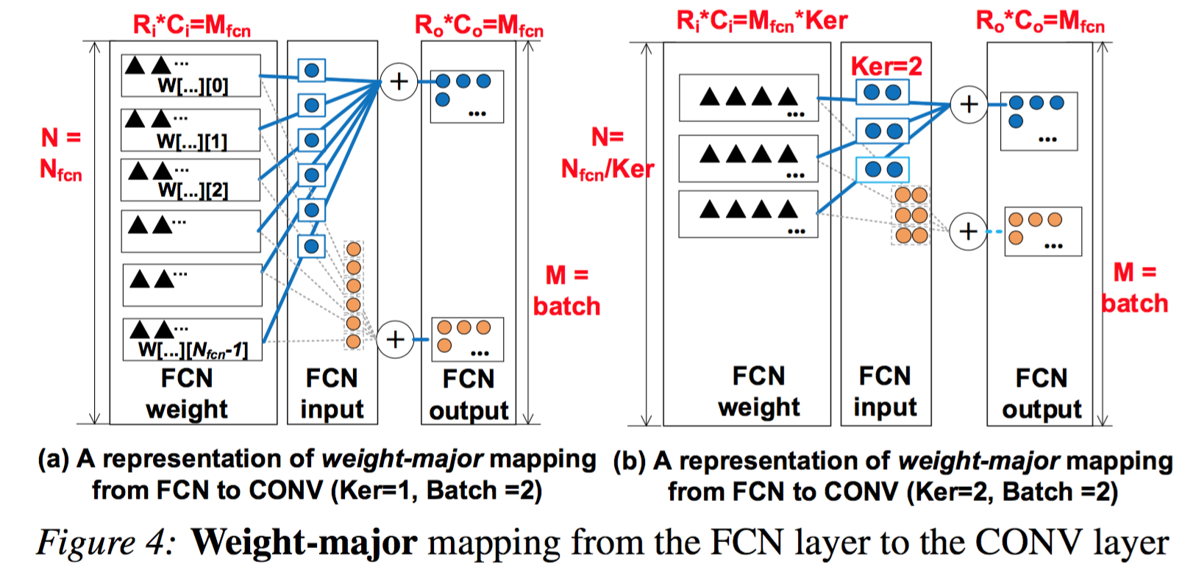
Reversed (weight-major) Mapping from FCN to CONV

Slide 60
Caffeine:
Software/Hardware Co-designed FPGA-based deep learning library
Challenge 1：
Programmability
Automated flow
Uniformed-representation for CONV/FCN computation pattern
Portable HLS implementation
Scalable systolic PE array design
Challenge 2 :
Scalability

Slide 61
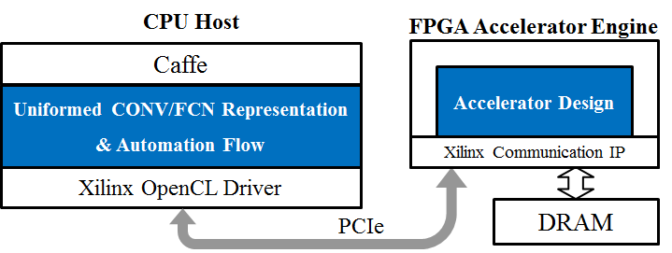
Platform Overview:
A FPGA-based deep learning library for online system
CPU
Interconnect
FPGA

Slide 62
N1
P1
R1
C1
N2
R2
N3
R3
C2
C3
R1
R2
R3
Fully connect
Fully connect
Input Image
Conv
Pool
ReLU
Conv
ReLU
Conv
ReLU
Fully connect
F3
F1
F2
Lc
Lf

Slide 63
Fully connect
Fully connect
Input Image
Conv
Pool
ReLU
Conv
ReLU
Conv
ReLU
Fully connect

Slide 64
Input Image
Conv
Pool
ReLU
Conv
ReLU
Conv
ReLU

Slide 65
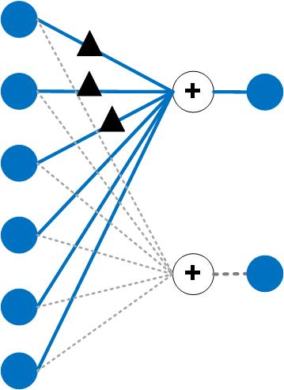
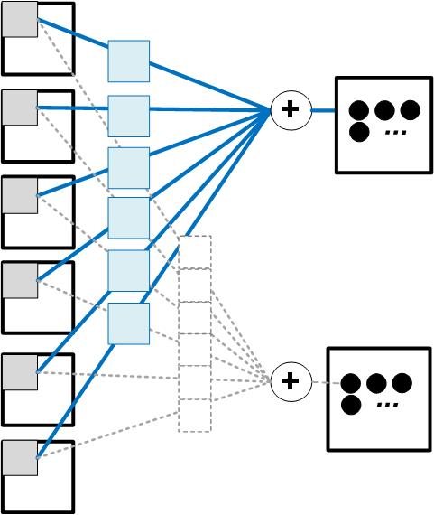
Uniformed Representation: Input-major mapping
Conv input feature maps
FCN input vector
FCN weight
Conv weight kernel
FCN output vector
Conv output feature maps

Slide 66
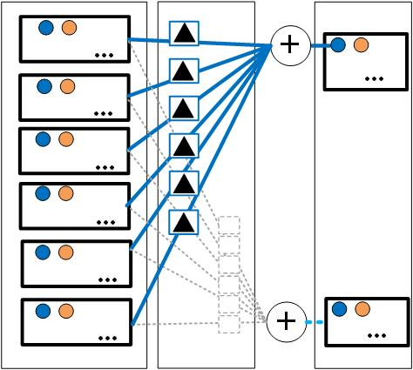
Uniformed Representation: Input-major mapping
Conv weight kernel
FCN weight
Conv input feature maps
Conv output feature maps
FCN input vector
FCN output vector

Slide 67
Improve Effective Bandwidth by Increasing

Slide 68
Comparison with Other FPGA Work
[1]
[2]
[3]
DSP # | 2240 | 780 | 1963 | 1058 | 2833
CONV GOPS | 61.6 | 187.8 | 136.5 | 310 | 488
GOPS/DSP | 0.0275 | 0.241 | 0.069 | 0.293 | 0.17
[1] C. Zhang et al., “Optimizing fpga-based accelerator design for deep convolutional neural networks,” in FPGA. ACM, 2015, pp. 161–170.
[2] J. Qiu et al., “Going deeper with embedded fpga platform for convolutional neural network,” in FPGA. ACM, 2016, pp. 26–35.
[3] N. Suda et al., “Throughput-optimized opencl-based fpga accelerator for largescale convolutional neural networks,” in FPGA. ACM, 2016, pp. 16–25.

